Slide 1
Setter Injection with Map having Dependent Object
We can inject collection values by setter method in spring framework.
We can use three elements inside the property element. It can be:
list
set
map

Slide 2
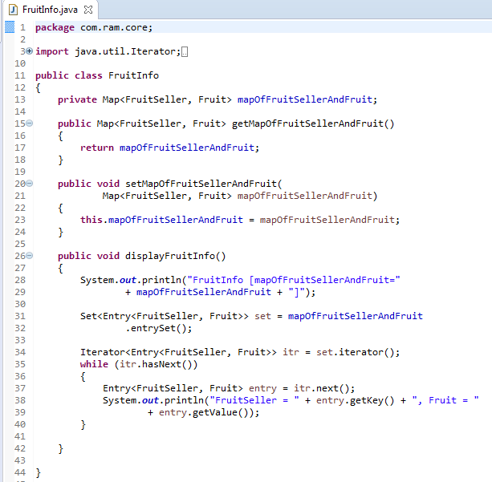
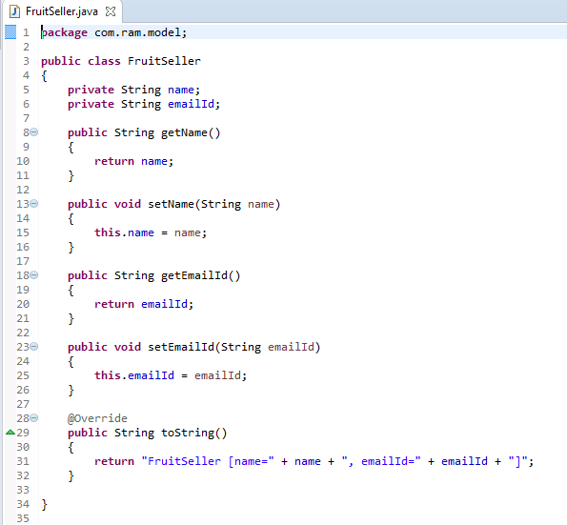
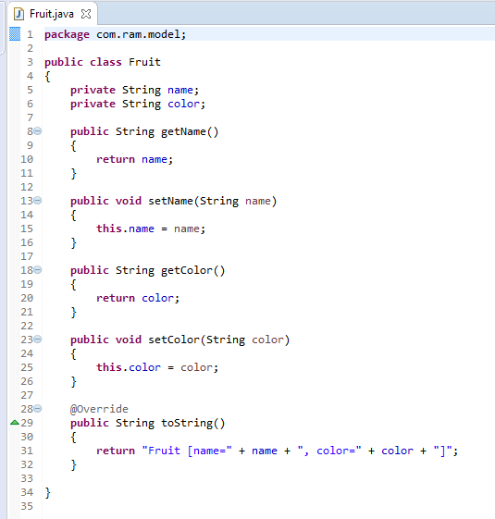
Setter Injection with Map having Dependent Object

Slide 3
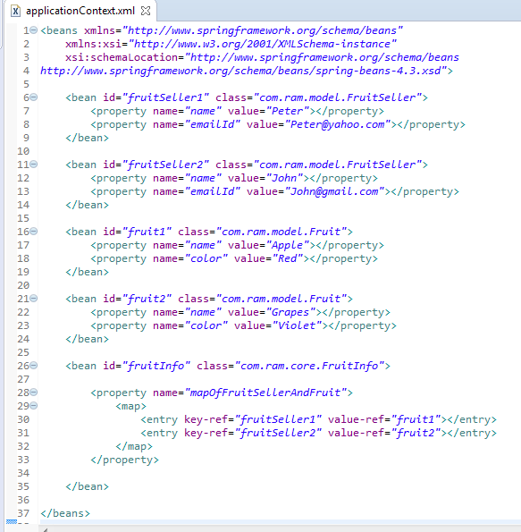
Setter Injection with Map having Dependent Object
We are providing the information into the bean by applicationContext.xml file.
The property element invokes the setter method.
The entry attribute of map is used to define the key and value information.
The key-ref and value-ref attributes of entry element is used to define the reference of bean in the map.
The map element of constructor-arg is used here to define the map.

Slide 4
Setter Injection with Map having Dependent Object
FruitInfo
What object to instantiate?
What object to configure and how to configure?
The Spring Container
(ApplicationContext)
applicationContext.xml
FruitInfo
Object
FruitInfo [mapOfFruitSellerAndFruit={FruitSeller
[name=Peter,
emailId=Peter@yahoo.com]=Fruit [name=Apple,
color=Red], FruitSeller
[name=John,
emailId=John@gmail.com]=
Fruit [name=Grapes, color=Violet]}]
Create the FruitInfo object.
Configure the FruitInfo object.
Manage FruitInfo object complete life cycle from creation till destruction.

Slide 5
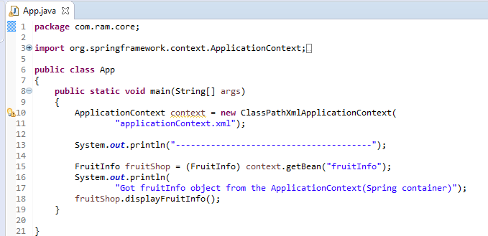
Setter Injection with Map having Dependent Object
Jan 05, 2018 3:34:20 PM org.springframework.context.support.AbstractApplicationContext prepareRefresh
INFO: Refreshing org.springframework.context.support.ClassPathXmlApplicationContext@69663380: startup date [Fri Jan 05 15:34:20 IST 2018]; root of context hierarchy
Jan 05, 2018 3:34:20 PM org.springframework.beans.factory.xml.XmlBeanDefinitionReader loadBeanDefinitions
INFO: Loading XML bean definitions from class path resource [applicationContext.xml]
FruitSeller(String name, String emailId) constructor is called by the Spring container
FruitSeller(String name, String emailId) constructor is called by the Spring container
Fruit(String name, String color) constructor is called by the Spring container
Fruit(String name, String color) constructor is called by the Spring container
FruitInfo(Map<FruitSeller, Fruit> mapOfFruitSellerAndFruit) constructor is called by the Spring container
---------------------------------------
Got fruitInfo object from the ApplicationContext(Spring container)
FruitInfo [mapOfFruitSellerAndFruit={FruitSeller [name=Peter, emailId=Peter@yahoo.com]=Fruit [name=Apple, color=Red], FruitSeller [name=John, emailId=John@gmail.com]=Fruit [name=Grapes, color=Violet]}]
FruitSeller = FruitSeller [name=Peter, emailId=Peter@yahoo.com], Fruit = Fruit [name=Apple, color=Red]
FruitSeller = FruitSeller [name=John, emailId=John@gmail.com], Fruit = Fruit [name=Grapes, color=Violet]

